Slide 1
Databases & SQL
Week 7, Summer 2024. 7/29 (Mon)
Lecture 22

Slide 2
Announcements
Only two more lectures of (testable) content!
Databases & SQL (today), SQL (tomorrow)
"Official" course evaluation survey released
https://course-evaluations.berkeley.edu/Berkeley/
Filling this out will be a huge help for the Data/DSUS department with regard to course development, so please fill this out :)
"Unofficial" Mid-semester survey due tonight (7/29, 11:59 PM PST)
Filling this out helps us improve the course, and helps course staff improve. And, +2 pts Extra Credit!

Slide 3
Announcements: AMA Questions Thread
Wednesday lecture (7/31) will have an "AMA" (Ask Me Anything) portion
(optional) Post your questions in the Ed post: "AMA" Lecture Questions Thread

Slide 4
Announcements: Final Exam
Final exam "primary" time: Wednesday August 7th, 3PM – 5 PM PST
Final exam scheduling form released
Gradescope: "(Urgent) Final Exam Scheduling"
Due: Wednesday July 31st 11:59 PM PST
Please fill this out ASAP! For more info, see Ed post.
DSP students: you should have received an email for a separate Final exam scheduling form. Please fill this out – if you didn't receive an e-mail, let us know!
Final exam will have the same style as the Midterm
Zoom+Gradescope

Slide 5
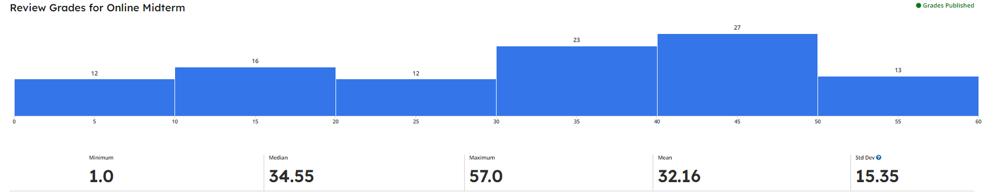
Announcements: Midterm
Midterm grades released on Gradescope
Regrade requests via Gradescope (Due date: Fri 8/2 11:59 PM PST)
Note: regrade requests must be specific and well-justified. Spamming erroneous regrade requests may result in negative repercussions. (Gradescope guide: How to submit regrade requests)

Slide 6
Why SQL? (Review)
SQL is a declarative programming language for accessing and modifying data in a relational database.
It is an entirely new way of thinking (“new” in 1970, and new to you now!) that specifies what should happen, but not how it should happen.
One of a few major programming paradigms
Imperative/Procedural
Object Oriented
Functional
Declarative

Slide 7
What is SQL?
A declarative language
Described what to compute
Imperative languages, like python, describe how to compute it
Query processor (interpreter) chooses which of many equivalent query plans to execute to perform the SQL statements
ANSI and ISO standard, but many variants
We will learn just the basics.
CS88's SQL will work on nearly all relational databases—databases that use tables.

Slide 8
SQL Statements
SELECT statement creates a new table, either from scratch or by projecting a table
CREATE TABLE statement gives a global name to a table
Lots of other statements
analyze, delete, explain, insert, replace, update, …
SQL queries, aggregates, updates data in a database.
SQL is case-insensitive
But the data can be case-sensitive. (We'll talk about this later...)

Slide 9
What does SQL Look Like?
SELECT date, COUNT(*)
FROM users
WHERE date > "2024-06-01"
GROUP BY date;
This query means: From the `users` table, fetch all rows whose `date` column is > `current_date`, group them by `date`, and count how large each group is.
Note: query results are also a table!
user_name | date
"bob" | 2024-06-01
"alice" | 2024-06-01
"louis" | 2024-06-02
"alyssa" | 2024-06-03
… | …
date | count
2024-06-02 | 136
2024-06-03 | 257
2024-06-04 | 326
2024-06-05 | 167
… | …
There are 257 rows with date=2024-06-03
`users` table
Query results

Slide 10
Why Databases?
• Data lives in files: website access logs, in images, in CSVs and so on…
• Useful, but hard to access, aggregate and compute results.
• Databases provide a mechanism to store vast amounts of data in an organized manner.
• They (often) rely on ”tables” as an abstraction.
• There are other kinds of databases, that store “documents” or other forms of data.
• Databases is the topic of CS186
• Elsewhere: Data, its storage and accessing it are critical to data science.

Slide 11
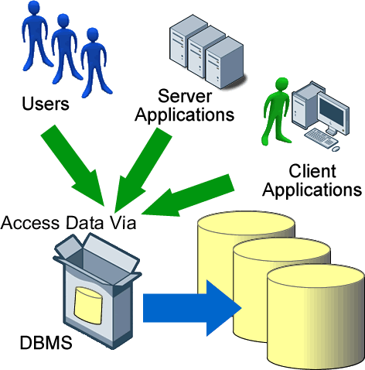
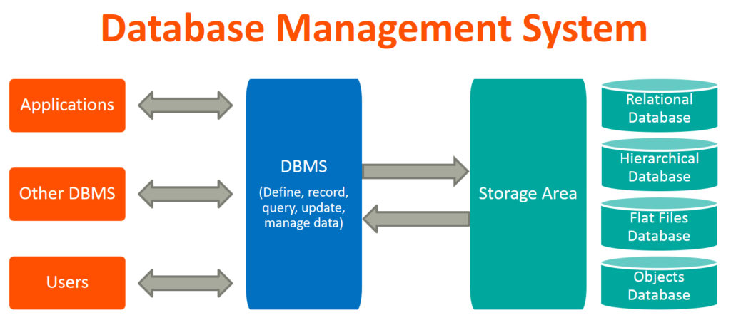
Database Management Systems
Applications.
Ex: a data scientist wants to perform exploratory data analysis on a health dataset.
Ex: a DS wants to see if a website change improved user engagement metrics.
Interface between Users and underlying data.
Provides an abstraction layer so that Users can focus on solving problems (eg data science) instead of data details (eg how the underlying data is stored, etc)
Ex: MySQL, sqlite3
Data implementation details. Data file format (binary, text, CSV, parquet). Data location (cloud vs on-site). Techniques to arrange data to optimize for access.

Slide 12
Applications Issue Queries to a Database
User
Application
Classes & Objects
Database Query Processor,
i.e., Interpreter
Response
Tables
Python Interpreter
SQL query
The SQL language is represented in query strings delivered to a DB backend.
Use the techniques learned here to build clean abstractions.
You have already learned the relational operators!

Slide 13

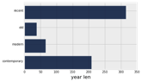
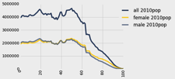
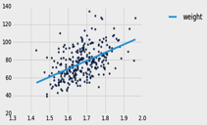
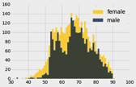
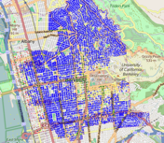
Data 8 Tables, datascience
ordered collection of labeled columns of anything
label
select, where, take, drop, group
dict, record,tuple
pivot, pivot_bin
values
split
join
Numpy array
T[‘label’]
A single, simple, powerful data structure for all
Inspired by Excel, SQL, R, Pandas, etc.

Slide 14
Database Management Systems
DBMS are persistent tables with powerful relational operators
Important, heavily used, interesting!
A table is a collection of records, which are rows that have a value for each column
Structure Query Language (SQL) is a declarative programming language describing operations on tables
column has a name and a type
row has a value for each column
Name | Latitude | Longitude
Berkeley | 38 | 122
Cambridge | 42 | 71
Minneapolis | 45 | 93
table has columns and rows

Slide 15
You've seen (and used) databases
CSV files: A database with one table
Excel / Google Sheets:
Each "tab" is a table, with rows and columns
A datascience Table is not a database, but is similar
Websites are backed by databases
bCourses, Gradescope, etc have a table of users, assignments, etc
These tables have standardized rows and columns

Slide 16



Data: structured vs unstructured
Structured data: in practice, means "tabular" data
Ex: tables, spreadsheets. Each row follows a set schema
Unstructured data: everything else
raw text logs
images/videos
In practice: people will ingest unstructured data (eg User engagement logs) and process them into a structured format
Name | Latitude | Longitude
Berkeley | 38 | 122
Cambridge | 42 | 71
Minneapolis | 45 | 93
[2024-06-01 00:23:01] User 'louis' logged in
[2024-06-01 00:23:02] User 'alice' logged in
[2024-06-01 00:23:32] User 'alice' defeated 'louis'
[2024-06-01 00:23:32] User 'alice' leveled up!
[2024-06-01 00:23:38] User 'louis' messaged 'lol'
[2024-06-01 00:23:40] User 'louis' logged out
...
In this class (C88C) we'll focus on structured (tabular) data, which SQL excels at

Slide 17
Interacting With A Database

Slide 18
sqlite3 [SQLite Docs]
Pronounced "sequel lite"
It's lightweight, fast, and works on most computers natively
It’s incredibly popular! Used by iOS, Android, Apple apps, and even airplanes!
But sqlite is not setup for all applications, like such as websites like Gmail/bCourses, etc.
A database is a .db file, which contains all of your data in an efficient form (eg compressed, postprocessed, etc).
Many people connect to sqlite through a program like Python OR through the sqlite interpreter.

Slide 19
sqlite3 [Python Docs]
sqlite3 is a Python module which connects to a SQLite database
This is the first time you write code that really interacts with data on your computer!
We can modify and delete data!
There's some "boilerplate" setup here, but it's not too bad…
Note: in this class (C88C) we will NOT be using Python+sqlite3 for SQL, instead we'll primarily be using the SQL interactive console. So, the next few slides are for "fun"
More of a glimpse into how language wrappers on top of SQL exists

Slide 20
Connecting To a Database (Python 3)
DB_FILENAME = '24-Databases_and_SQL.db' import sqlite3
# Talking to the database happens through a "connection"
con = sqlite3.connect(DB_FILENAME)
# A cursor is the object we use to execute a query.
cur = con.cursor() # This returns an iterator!
result = cur.execute("YOUR QUERY")
for row in result:
print(result) # This is a Tuple! # Save (commit) the changes
con.commit() # We can also close the connection if we are done with it.
# Just be sure any changes have been committed or they will be lost.
con.close()

Slide 21
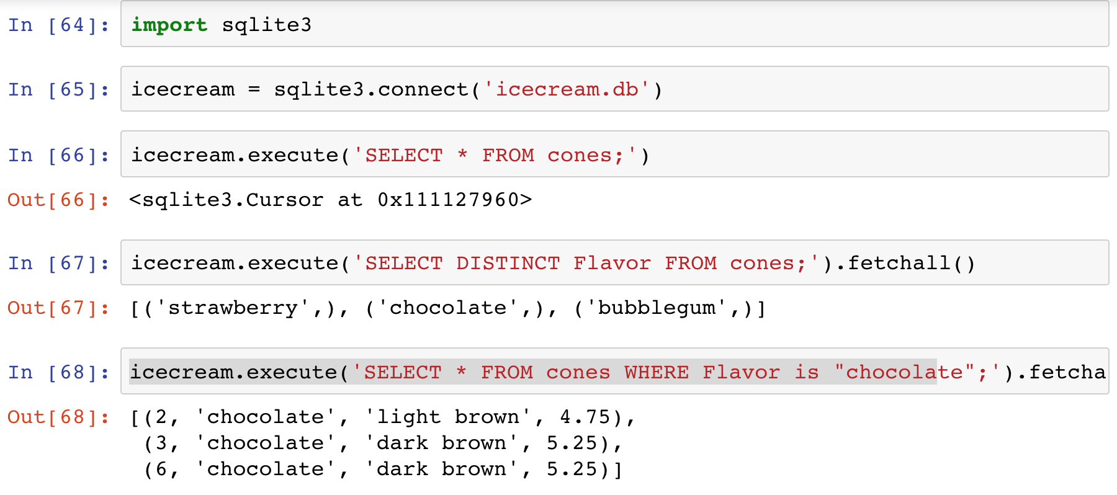
SQLite Python API – In a Notebook.

Slide 22
The sqlite console
Interactive console used via the Terminal!
Everything is saved automatically. BEWARE!
👉 sqlite3 24-Databases_and_SQL.db
SQLite version 3.37.0 2021-12-09 01:34:53
Enter ".help" for usage hints.
sqlite> .help
.echo on|off Turn command echo on or off
.exit ?CODE? Exit this program with return-code CODE
.headers on|off Turn display of headers on or off
.help ?-all? ?PATTERN? Show help text for PATTERN
.quit Exit this program
.show Show the current values for various settings
.tables ?TABLE? List names of tables matching LIKE pattern TABLE
.trace ?OPTIONS? Output each SQL statement as it is run
sqlite> .tables
cones sales
There are many more commands than the ones shown here!, but these can be neat!
(Not required for this class) To install sqlite3, visit https://www.sqlite.org/download.html

Slide 23
C88C sqlite_shell.py interactive console
C88C has a special sqlite_shell.py script just for the class! Similar in spirit to the `sqlite3` executable. This is what we'll use for labs/homeworks!
Everything is saved automatically. BEWARE!
👉 python3 sqlite_shell.py 24-Databases_and_SQL.db
This .db file is a persistent file that lives on your computer that contains your tables/data in a special format that sqlite_shell.py knows how to work with.
Notably: making changes to tables within your sqlite_shell.py session will modify your .db file, meaning changes persist between sqlite_shell.py sessions! Neat!
Aka "mutation" on a file-system level.
SQLite version 3.40.1 (adapter version 2.6.0)
Enter ".help" for usage hints.
sqlite> .help
.cd DIRECTORY Change the working directory to DIRECTORY
.dump Dump the database in an SQL text format
.exit Exit this program
.help Show this message
.open FILE Close existing database and reopen FILE
.print STRING... Print literal STRING
.quit Exit this program
.read FILENAME Execute SQL in FILENAME
.schema ?PATTERN? Show the CREATE statements matching PATTERN
.show Show the current values for various settings
.tables ?TABLE? List names of tables
sqlite> .tables
sales
cones

Slide 24
Introduction to SQL

Slide 25
SQL Statements
Statements operate on tables inside a database.
SELECT statement creates a new table, either from scratch or by projecting a table
CREATE TABLE statement gives a global name to a table
Lots of other statements
analyze, delete, explain, insert, replace, update, …
SQL queries, aggregates, updates data in a database.
SQL is case-insensitive

Slide 26
SQL example
SQL statements create tables
Give it a try with sqlite3 or code.cs61a.org
Each statement ends with ‘;’
Tip: "transient in-memory database" means "we're not using a persistent db file", aka "data changes will NOT persist after exiting this sqlite3 session
cs88 $ sqlite3
SQLite version 3.9.2 2015-11-02 18:31:45
Enter ".help" for usage hints.
Connected to a transient in-memory database.
Use ".open FILENAME" to reopen on a persistent database.
sqlite> select 38 as latitude, 122 as longitude, "Berkeley" as name;
38|122|Berkeley
sqlite>

Slide 27
SQL Basics
SQL Keywords are case-insensitive
e.g. SELECT and select do the same thing
I try to capitalize them to make it clear what's-what.
The order of SQL keywords matters
e.g. SELECT ... FROM … WHERE …
Every statement ends in a ;
Whitespace doesn't matter
But indentations and newlines help make queries readable!
Despite being a standard, differences do exist between databases. We use sqlite3.

Slide 28
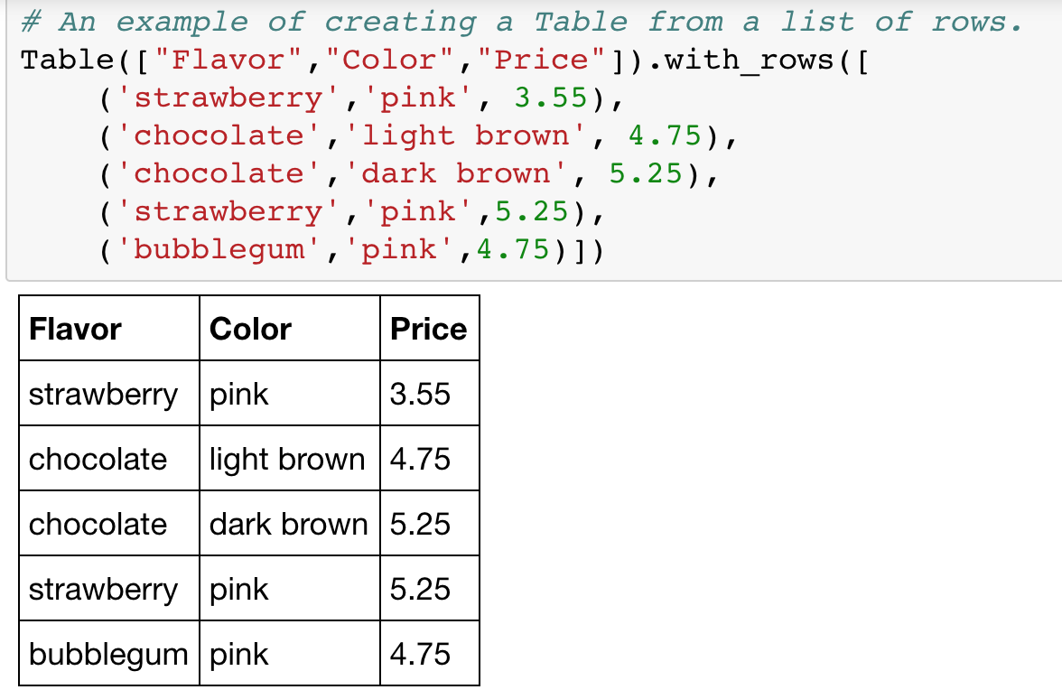

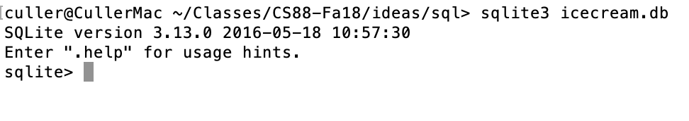
A Running example from Data 8

Slide 29
SELECT
Comma-separated list of column descriptions
Column description is an expression, optionally followed by as and a column name
Selecting literals creates a one-row table
union of select statements is a table containing the union of the rows
SELECT [expression] AS [name], [expression] AS [name]; . . .
select "strawberry" as Flavor, "pink" as Color, 3.55 as Price;
select "strawberry" as Flavor, "pink" as Color, 3.55 as Price union
select "chocolate","light brown", 4.75 union
select "chocolate","dark brown", 5.25 union
select "strawberry","pink",5.25 union
select "bubblegum","pink",4.75;

Slide 30
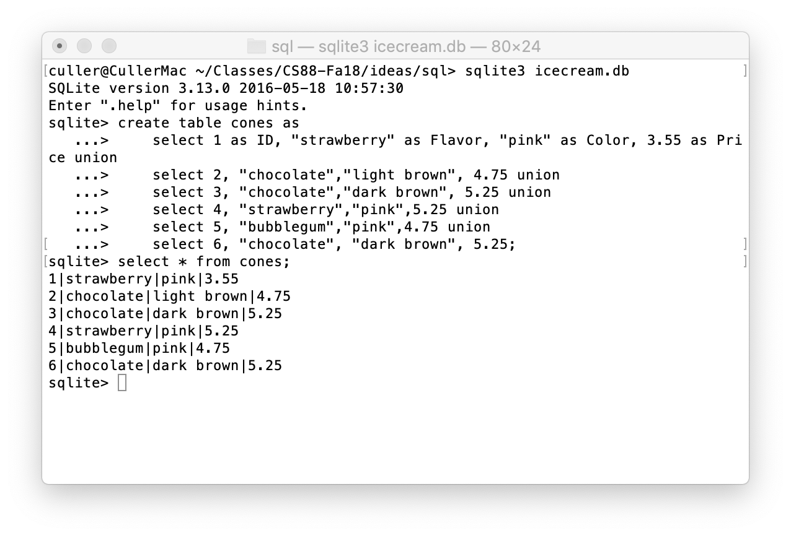
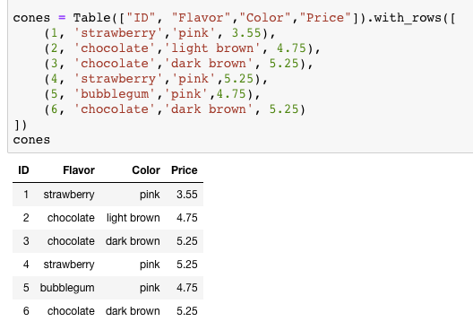
Select …

Slide 31
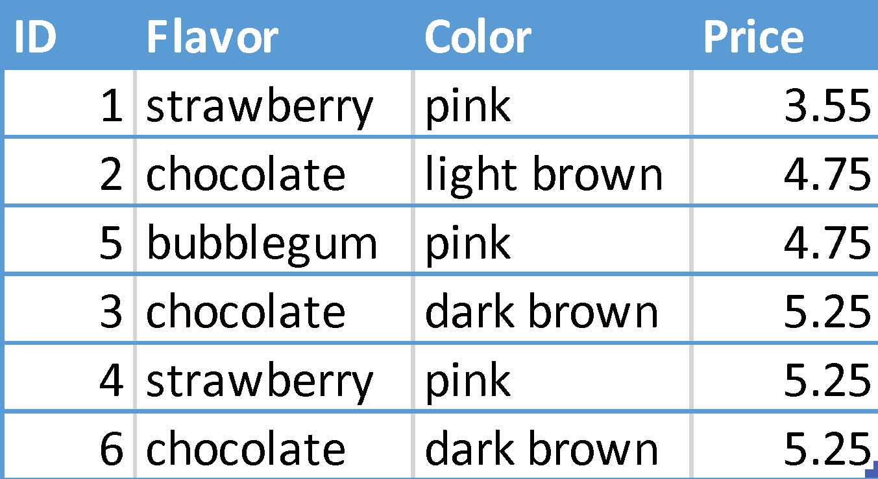
Projecting existing tables
Input table specified by from clause
Subset of rows selected using a where clause
Ordering of the selected rows declared using an order by clause
select [columns] from [table] where [condition] order by [order] ;
SELECT * FROM cones ORDER BY Price;

Slide 32
Wildcards
What if we want to SELECT all columns and all rows in a table?
What does * do?
The asterisk (or star) is a stand-in to mean "any value"
SELECT * … means "Select all columns"
Outside of SQL, * is a very common operator:
Regular Expressions (in DATA 100 / CS 61B) * means match "any character"
In Unix/Linux (macOS) * is a wildcard in the command line.

Slide 33
What's different about this table? IDs!
In practice, every row or record in a table should have a unique unambiguous ID
Why?
How do we know if a record is the same as some other value?
A properly setup table will handle this for you. ☺
We'll see it's use in next lecture.

Slide 34
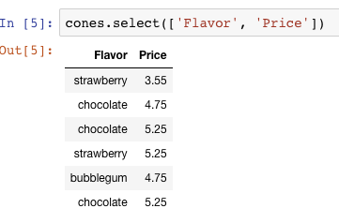
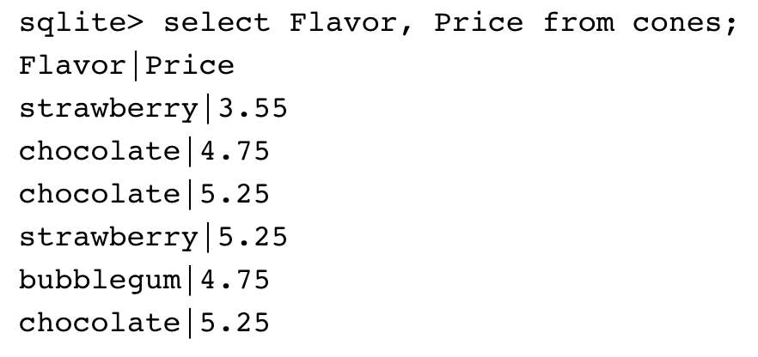
Projection
A “projection” is a view of a table, it doesn’t alter the state of the table.

Slide 35
Filtering in SQL

Slide 36
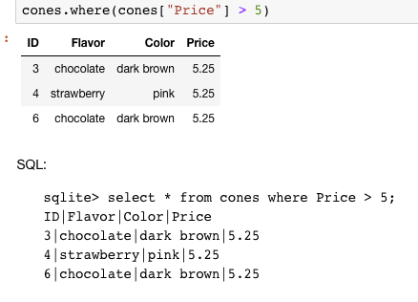
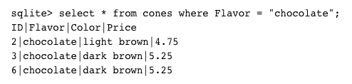
Filtering rows - where
Set of Table records (rows) that satisfy a condition
select [columns] from [table] where [condition] order by [order] ;

Slide 37
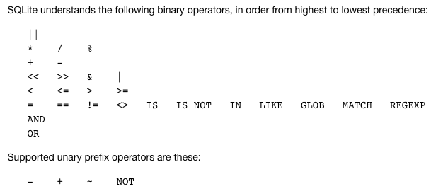
SQL Operators for predicate
use the WHERE clause in the SQL statements such as SELECT, UPDATE and DELETE to filter rows that do not meet a specified condition

Slide 38
Summary
SQL a declarative programming language on relational tables
largely familiar to you from data8
create, select, where, order, group by, join
Databases are accessed through Applications
e.g., all modern web apps have Database backend
Queries are issued through API
Be careful about app corrupting the database
Data analytics tend to draw database into memory and operate on it as a data structure
e.g., Tables

Slide 39
CREATE TABLE
SQL often used interactively
Result of select displayed to the user, but not stored
Create table statement gives the result a name
Like a variable, but for a permanent object
create table [name] as [select statement];

Slide 40
SQL: creating a named table
create table cones as
select 1 as ID, "strawberry" as Flavor, "pink" as Color, 3.55 as Price union
select 2, "chocolate","light brown", 4.75 union
select 3, "chocolate","dark brown", 5.25 union
select 4, "strawberry","pink",5.25 union
select 5, "bubblegum","pink",4.75 union
select 6, "chocolate", "dark brown", 5.25;
Notice how column names are introduced and implicit later on.

Slide 41
Summary – Part 1 (and SQL demo)
SELECT <col spec> FROM <table spec> WHERE <cond spec>
GROUP BY <group spec> ORDER BY <order spec> ;
INSERT INTO table(column1, column2,...)
VALUES (value1, value2,...);
CREATE TABLE name ( <columns> ) ;
CREATE TABLE name AS <select statement> ;
DROP TABLE name ;

